Slide 1

ENSEMBLE LEARNING
a road to have super models
Bagus Sartono
Department of Statistics – IPB University
in collaboration with: Gerry Alfa Dito and Fransdana Nadeak
Presented in the 9th Basic Science International Conference
Brawijaya University – Malang
20-21 March 2019

Slide 2
what is a super model?

Slide 3

“
definitely not these ones!

Slide 4
what is the super model?
how can ensemble help us?
some empirical results of super learner methodology
conclusion
outline

Slide 5


super predictive-model
has excellent accuracy
be tough in handling ill-conditioned datasets

Slide 6
demands on predictive models
business
propensity
risk
behavior
bio-science
risk of disease
content of substances
image analysis
predicting land-cover type from satellite image
education
predicting student performance

Slide 7
ensembling model could increase the model performance
fact or fake?

Slide 8




what is the ensemble approach?
base model #1
prediction #1
base model #2
prediction #2
final prediction
.
.
.
.
.
.
combiner
input
base model #k
prediction #k

Slide 9

milestones
1995
Adaboost ( Freud & Schapire)
Combiner (Chan & Stolfo)
1992 Stacking (Wolpert)
1996
Bagging ( Breiman)
1998
random subspace method (Ho)
1999
Wagging/Weight
aggregating(Bauer & Kohav)
2000
Cascade Generalization(Gama dan Brazdil)
2001
Random Forest ( Breiman)
Gradient Boosting Machine (Friedman)
2005
Modest AdaBoost (Vezhnevets & Vezhnevets)
Stacked sequential learning (Cohen & Carvalho)
2006
Rotation Forest (Rodriguez et al.)
2007
Super Learner (van der Laan, Polley, Hubbard)
2009
Troika (Menahem et al.)
2010
GA-stacking (Ledezma et al.)
2012
Sequential Stacking (Trivedi and Kapadia )
2014
Random projection random discretization ensembles (Ahmad & Brown)
2015
Deep neural decision forests (Kontschieder et al.)
2016
XGBoost - Extreme Gradient Boosting
(Chen & Guestrin)
2017
gcForest (Zhou & Feng)

Slide 10
accuracy of the ensemble: an illustration
5 base models, independent
accuracy level @70%
ensemble prediction → majority vote
correctly predict if at least 3 base models do so
accuracy of the ensemble:

Slide 11
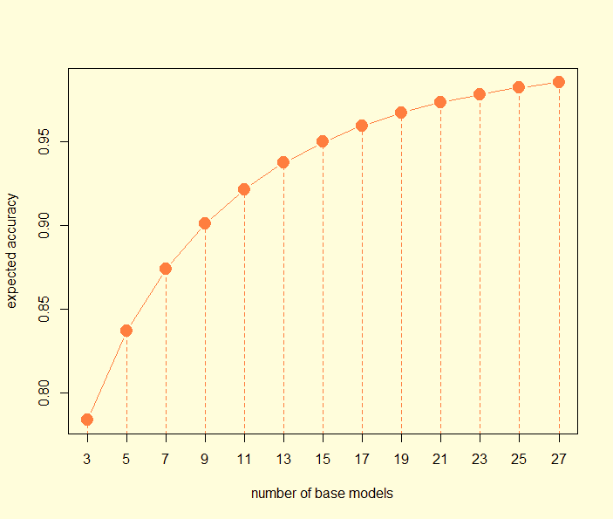
accuracy of the ensemble: an illustration

Slide 12
success story
Breiman L (2001). "Random Forests". Machine Learning. 45 (1): 5–32.

Slide 13
success story
Sean Whalen, Gaurav Pandey. 2013. A Comparative Analysis of Ensemble Classifiers: Case Studies in Genomics. ICDM 2013: 807-816
single model
ensemble approach

Slide 14

super learner methodology how to create the combiner?
training dataset
Partition data into k parts and run m base-models k times using obs from k-1 parts
Predict the other fold, as in k-fold CV predictions
Run a meta-learner algorithm to combine using predictions as predictors
Level-0 Data
Base Models
Level-1 Data
Meta Learner

Slide 15
some results
Gerry Alfa Dito & Bagus Sartono
Data Source:
UCI Machine Learning Repository
Datasets | Disc | NN | SVM | CART | Bagging | Boost | RF | Cascade | Super Learner
Australian | 85.9 | 84.2 | 86.9 | 85.9 | 87.9 | 87.4 | 87.2 | 86.8 | 89.9
Adult | 78.1 | 80.6 | - | 86.1 | 85.5 | - | 85.9 | 86.3 | 87.2
Heart Disease | 83.9 | 89.0 | 82.5 | 79.3 | 81.9 | 82.6 | 81.8 | 84.9 | 93.2
German | 78.0 | 75.0 | 75.0 | 72.1 | 77.2 | 77.1 | 73.8 | 77.0 | 78.0
Hepatitis | 78.4 | 81.9 | 85.4 | 80.5 | 83.5 | 86.2 | 85.2 | 84.7 | 87.1
Votes | 96.4 | 96.1 | 96.8 | 96.7 | 96.4 | 95.6 | 95.5 | 96.7 | 93.1
Breast Cancer | 94.5 | 98.1 | 96.2 | 95.1 | 96.8 | 97.0 | 97.4 | 97.4 | 99.3
Diabetes | 77.3 | 71.5 | 76.6 | 73.5 | 78.2 | 77.8 | 75.8 | 77.6 | 79.1
Ionosphere | 89.5 | 96.2 | 87.1 | 92.0 | 94.1 | 94.1 | 92.6 | 93.4 | 95.7
Sonar | 74.7 | 90.4 | 75.9 | 71.6 | 82.2 | 87.0 | 82.1 | 80.8 | 95.7

Slide 16
some results
Data Source:
Students’ theses, 2011 – 2018
Fransdana Nadeak, Bagus Sartono & Anwar Fitrianto
Dataset | Researcher | Year | Single Model
A1 | Resty Indah Sari | 2011 | Stepwise Discriminant
A2 | Gitania N Rahisti | 2015 | CART
A3 | Rindy Pertiwi (2) | 2013 | CHAID
A4 | Dimas Adiangga | 2015 | C5.0
A5 | Nur Fitriani | 2015 | QUEST
A6 | Nita Nurgenita | 2015 | Logistic Regression
A7 | Adi Nugraha | 2015 | Logistic Regression
A8 | Rossi A Barro | 2013 | Logistic Regression
A9 | Shafa R Surbakti | 2015 | Logistic Regression
A10 | Meita A Rubiati | 2014 | Logistic Regression
A11 | Alfin Khairi | 2014 | Logistic Regression
A12 | Rakhmawati | 2011 | Ridge Logistic Regression
A13 | Devi Adrian | 2018 | K-Nearest Neighbor
A14 | Dairul Fuhron | 2018 | Multivariate GLMM
A15 | Dairul Fuhron(2) | 2018 | Multivariate GLMM

Slide 17
conclusion
need a super model?
think ensemble!

Slide 18
thank you matur nuwun contact: bagusco@gmail.com bagusco@ipb.ac.id

